Slide 1

INT 200 : Human Pose Estimation for Arthritis disorder using Deep Learning Techniques
INT 200 Internship
First Review
Team Members
1. R.Tarun Raaj (E0221024)
2. K.Aakash (E0221041)
Project Guide Prof.B.Nirmala

Slide 2
Introduction
Pose Estimation is a computer vision task that infers the pose of a person or an object in an image or a video.
We can also think of pose estimation as the problem of determining the position orientation of a camera relative to a given person or an object.
This is typically done by identifying, locating, and tracking a number of key-points on a given person.
These key-points represent major joints like elbows, knees, shoulders, wrists, etc .
With pose estimation we’re able to track a person in real-world space at an incredibly granular level.

Slide 3
Problem statement (1/2)
Arthritis is a common disorder which is the swelling and tenderness of one or more joints.
The main symptoms of arthritis are joint pain and stiffness . Yoga is an effective way for the relief of Arthritis.
But , the problem with yoga is that , it is very important to practice it correctly as any incorrect posture during a yoga session can be unproductive.
This leads to the necessity of having an instructor to supervise the session and correct the individual’s posture. But all users do not have access or resources to an instructor.
So, we are going to develop a deep learning model that identifies the yoga poses and verifies whether the yoga poses predicted by the individual is correct or not.

Slide 4
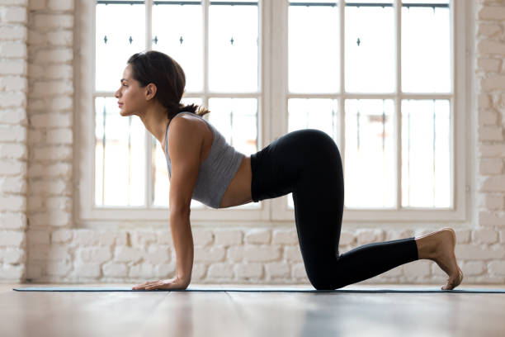
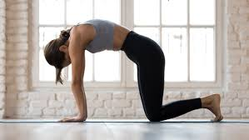
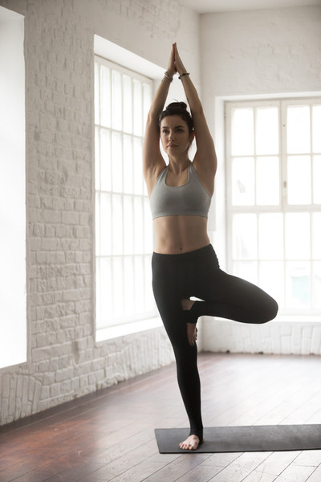
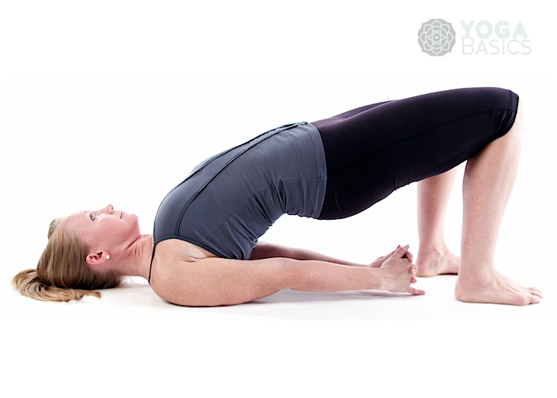
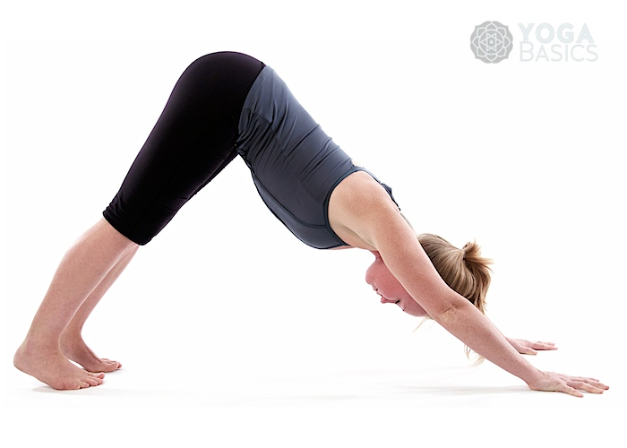
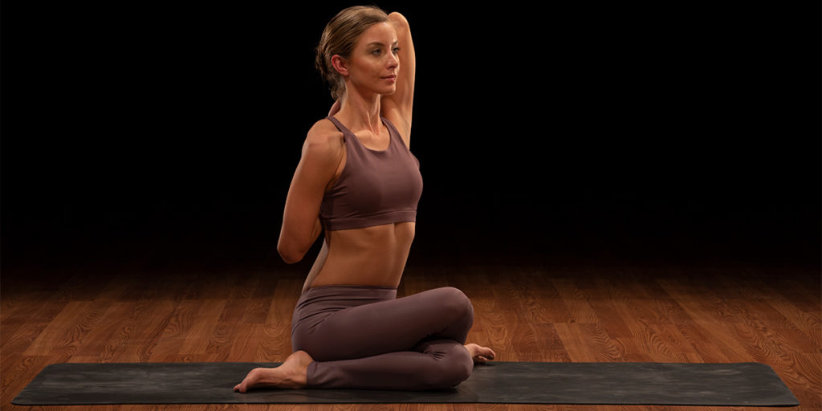
Problem statement (2/2)
The yoga poses that we are going to give as input are :
Cow Pose
Cat Pose
Tree Pose
Bridge Pose
Downward-facing Dog Pose
Cow Face Pose

Slide 5
Research survey
S.No | Title | Author | Year | Overview
1. | Yoga Pose Classification Using Deep Learning | Shruti Kothari | 2020 | Uses OpenPose for initial keypoint identification from videos as input followed by CNN for classification of yoga poses. Accuracy of 99%
2. | Yog.ai: Deep Lerning for Yoga | Anna Lai , Bhargav Reddy, Bruis Van Vijmen | 2019 | Uses OpenPose for initial keypoint identification from images as input followed by CNN for classification of yoga poses. Accuracy of 78%
3. | ExNET: deep neural network for exercise pose detection | Sadeka Haque , Akm Shahariar Azad Rabby, Monira Akter Laboni , Nafis Neehal | 2019 | Used CNN to detect human poses from 2D human exercise images and achieved an accuracy of 83%

Slide 6
Work Flow
Data collection
Data preparation
Serve model
Is it structured or unstructured?
What data exists?
Where can you get it ?Is it public ?Are there privacy concerns
Analysis/evaluation
Train a model
Exploratory data analysis
Data preprocessing
Data splitting
Choose an algorithm(based on your problem/data)
Overfit then regular size
Tune hyperparameters
Evaluation metrics
Feature importance
Training/inference cost
Worst examples
Put your model in production
Revaluate
Retrain model
Are old predictions still valid?
Continuous process
Collect more data for improving model

Slide 7
Work done (1/3)
GitHub repository on Machine Learning algorithms
Repository Link :
https://github.com/tarunraaj2003/Machine-Learning
Machine Learning
Machine learning is a branch of artificial intelligence(AI) and computer science which focuses on the use of data and algorithms to imitate the way that humans learn, gradually improving its accuracy.
Deep Learning
Deep learning is a subset of machine learning where neural networks
— algorithms inspired by the human brain — learn from large amounts of data.

Slide 8
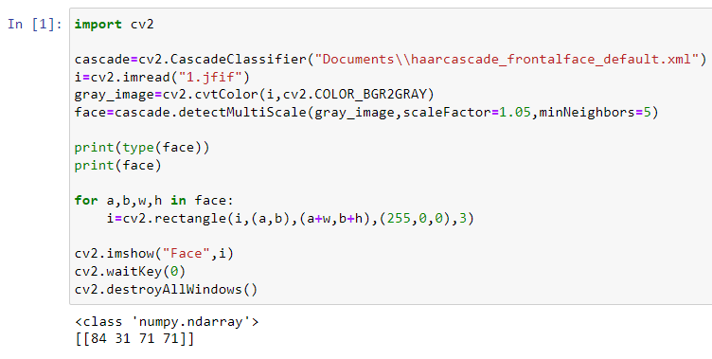
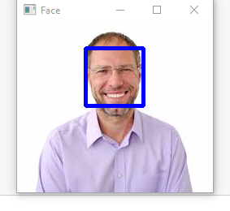
Work done (2/3)
Code on Face Detection in an image
CODE:
OUTPUT :

Slide 9
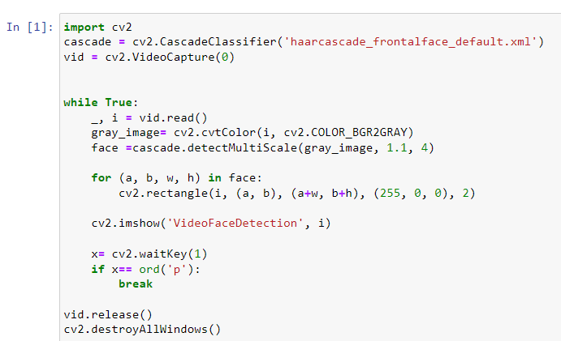
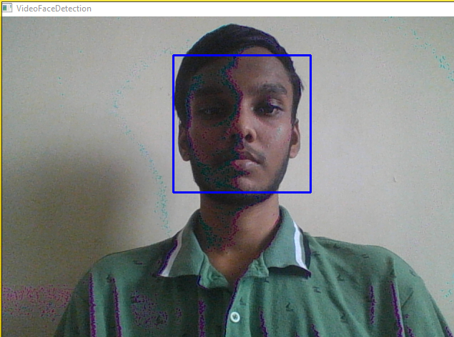
Work done (3/3)
Code on real-time face detection using webcams
GitHub repository on OpenCV
https://github.com/tarunraaj2003/OpenCV
OUTPUT :
CODE :

Slide 10
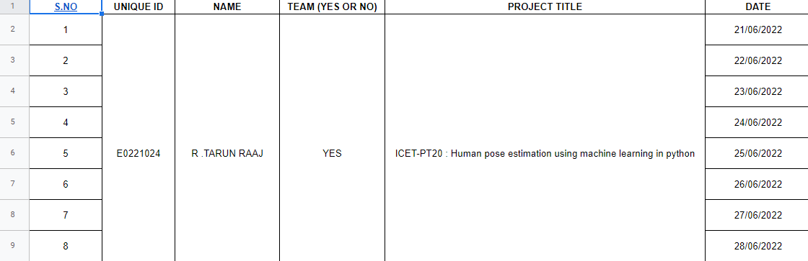
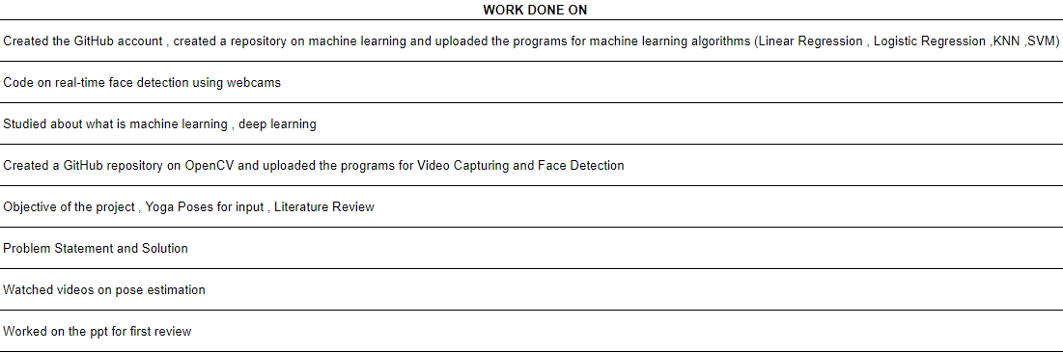
Timeline of the work

Slide 11
References
Papers :
https://scholarworks.sjsu.edu/cgi/viewcontent.cgi?article=1932&context=etd_projects
http://cs230.stanford.edu/projects_winter_2019/reports/15813480.pdf
https://www.researchgate.net/publication/334568621_ExNET_Deep_Neural_Network_for_Exercise_Pose_Detection
Videos:
https://youtu.be/UeXCqE7YNIY
https://youtu.be/-ZrDjwXZGxI
https://www.youtube.com/watch?v=06TE_U21FK4

Slide 12
Thank you

